Slide 1
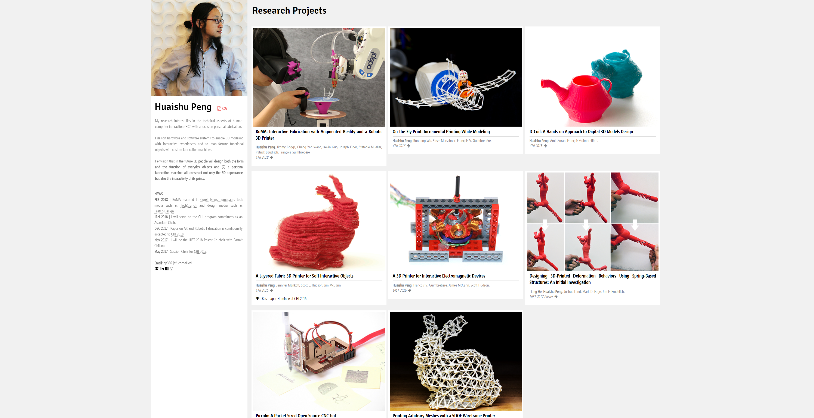

Slide 2
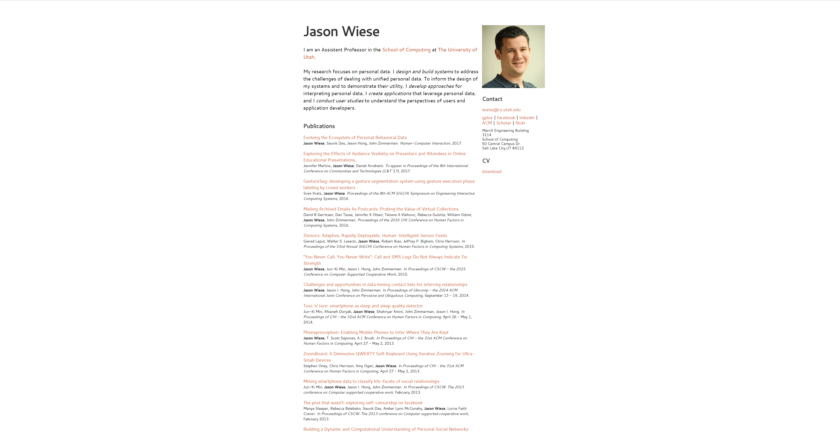

Slide 3
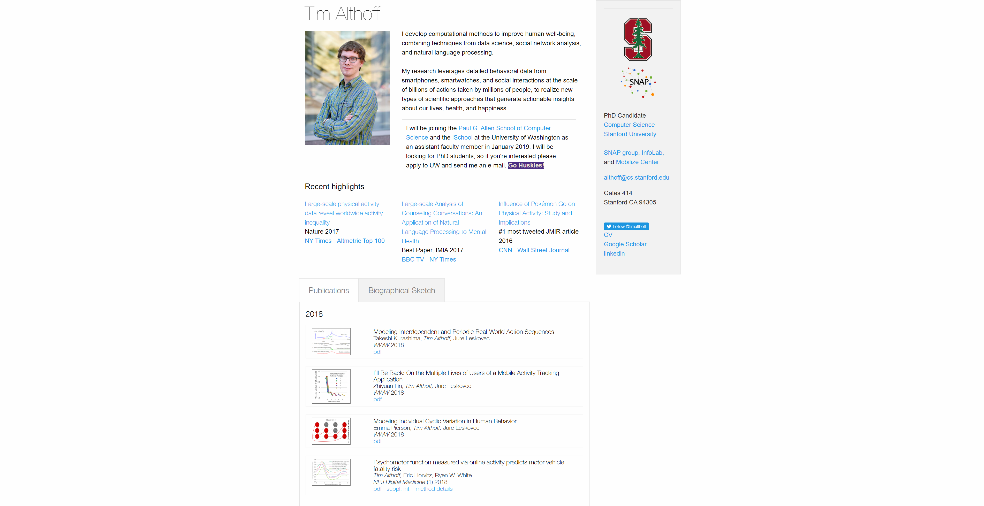
Notes:
http://timalthoff.de/

Slide 4
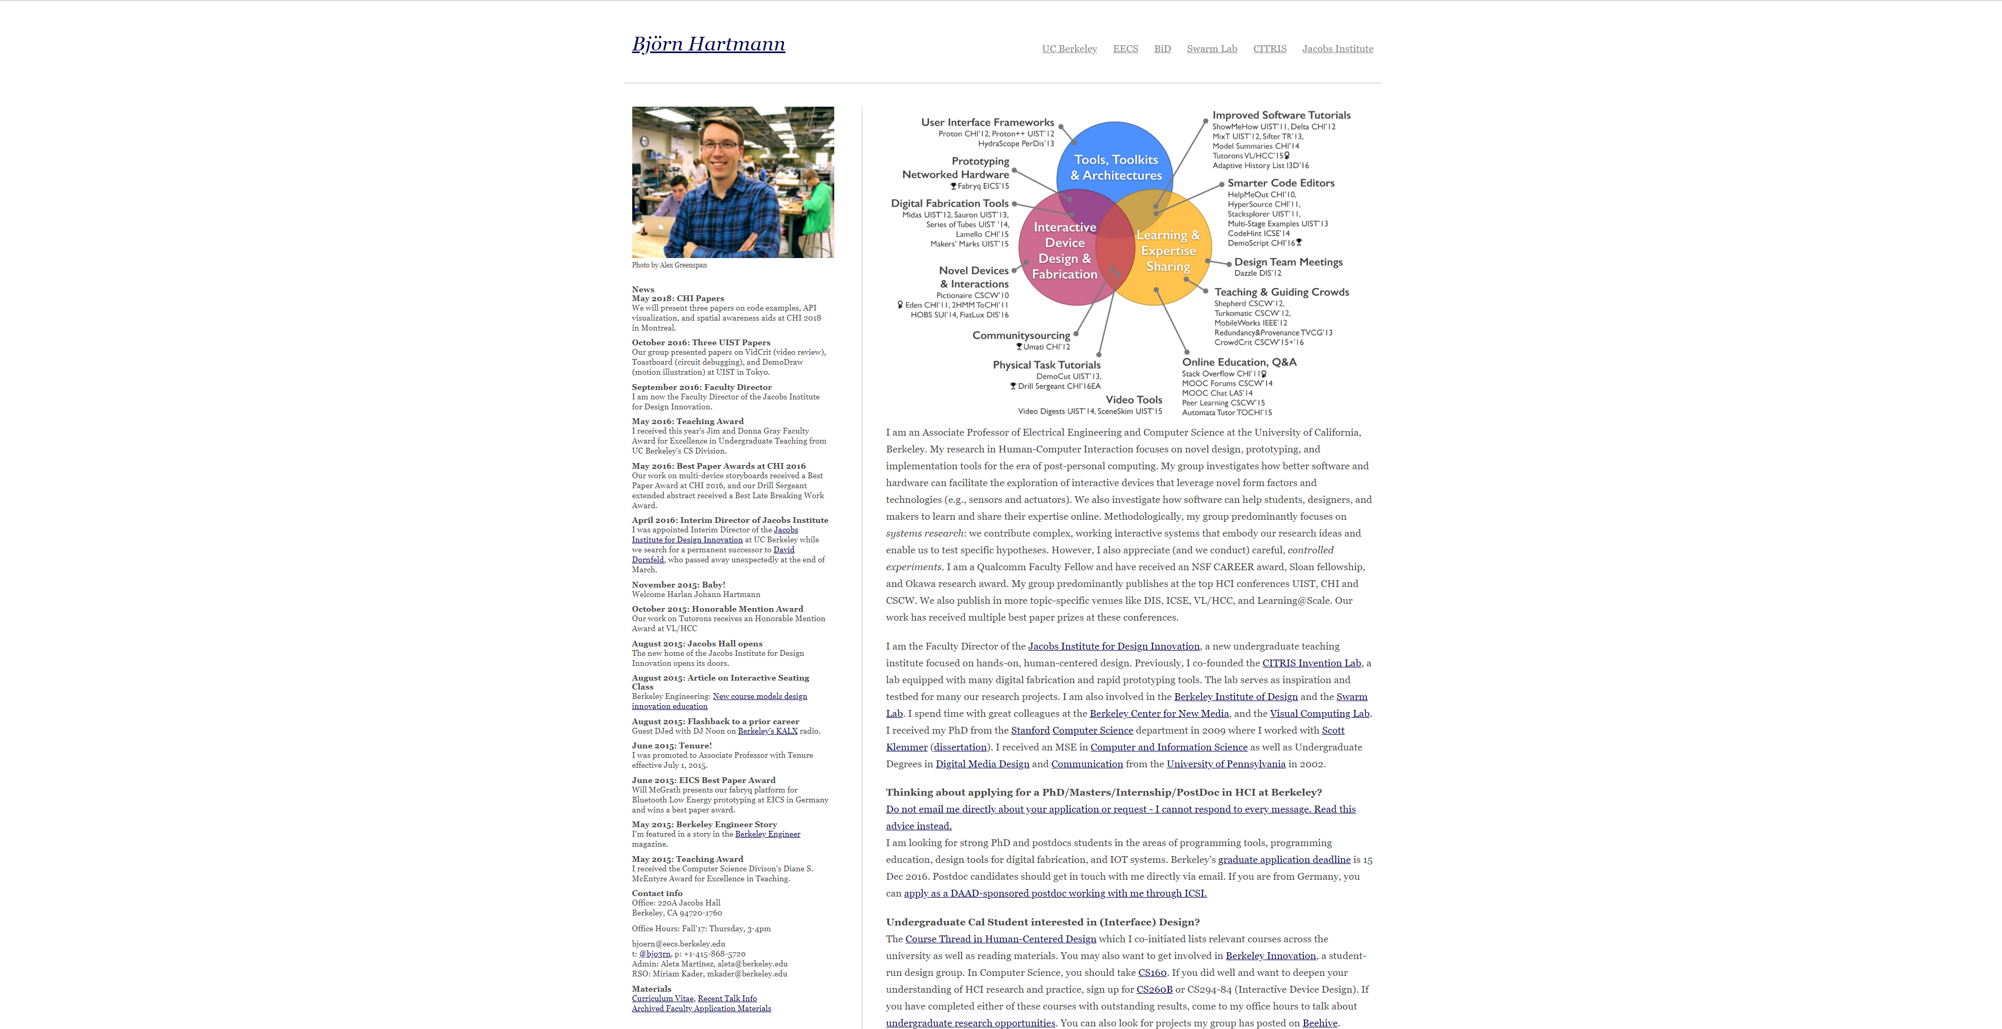

Slide 5
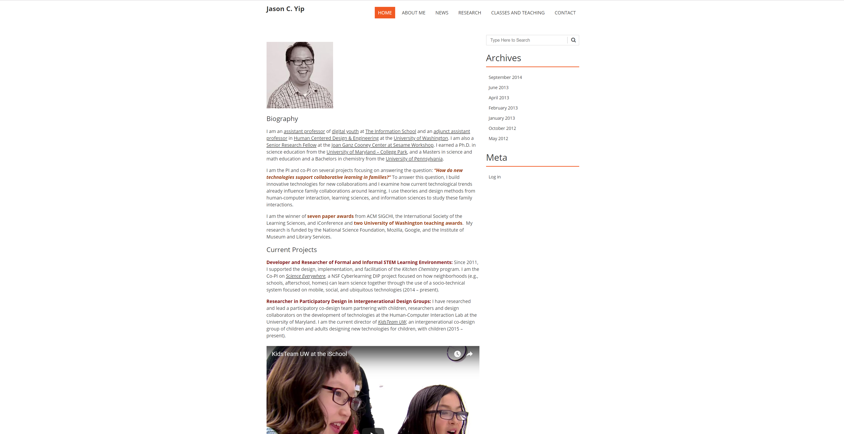

Slide 6
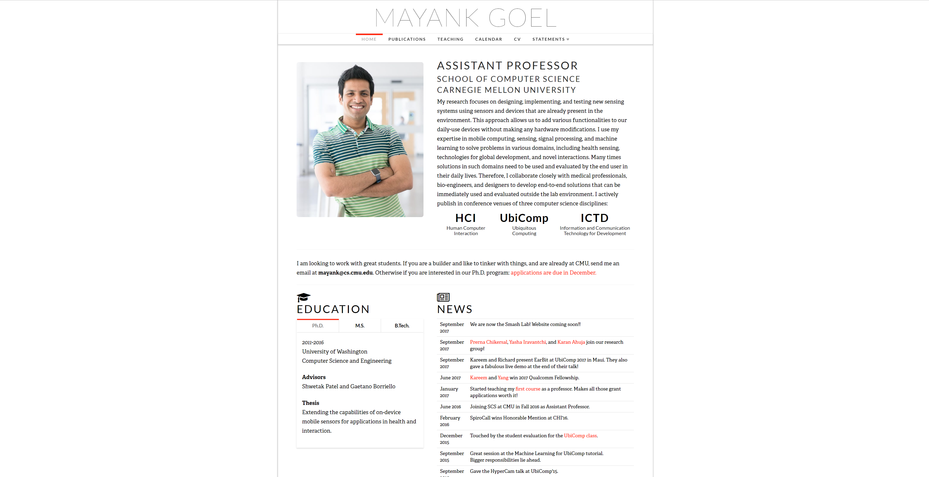
Notes:
http://www.mayankgoel.courses/

Slide 7
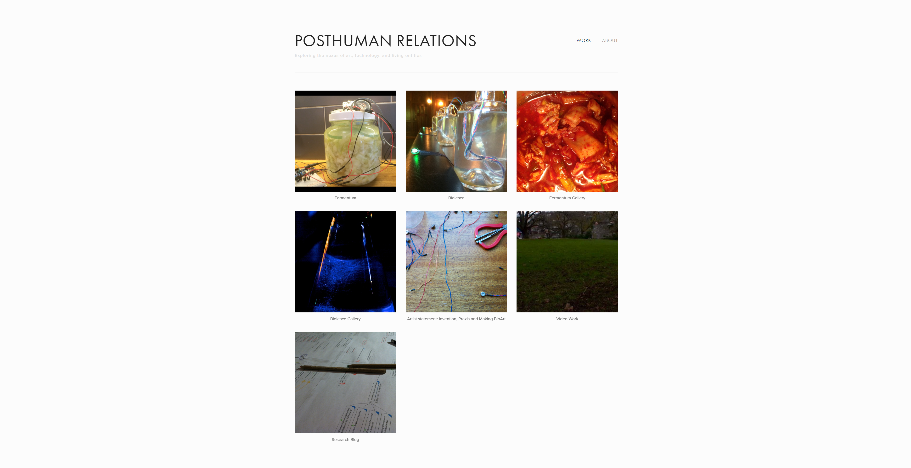
Notes:
Tyler Fox: http://www.tylersfox.com/

Slide 8
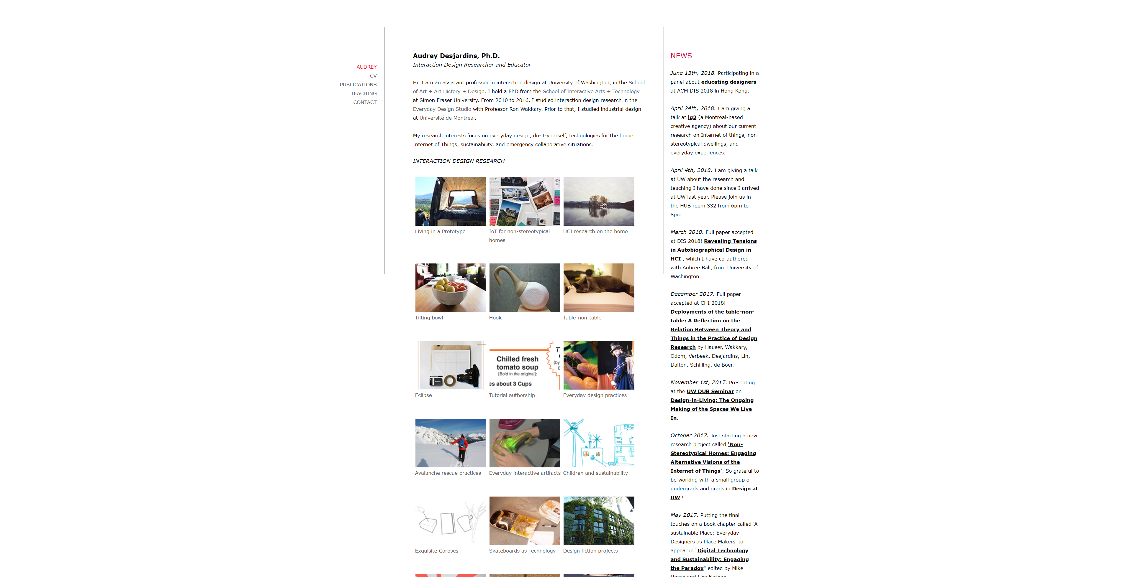

Slide 9
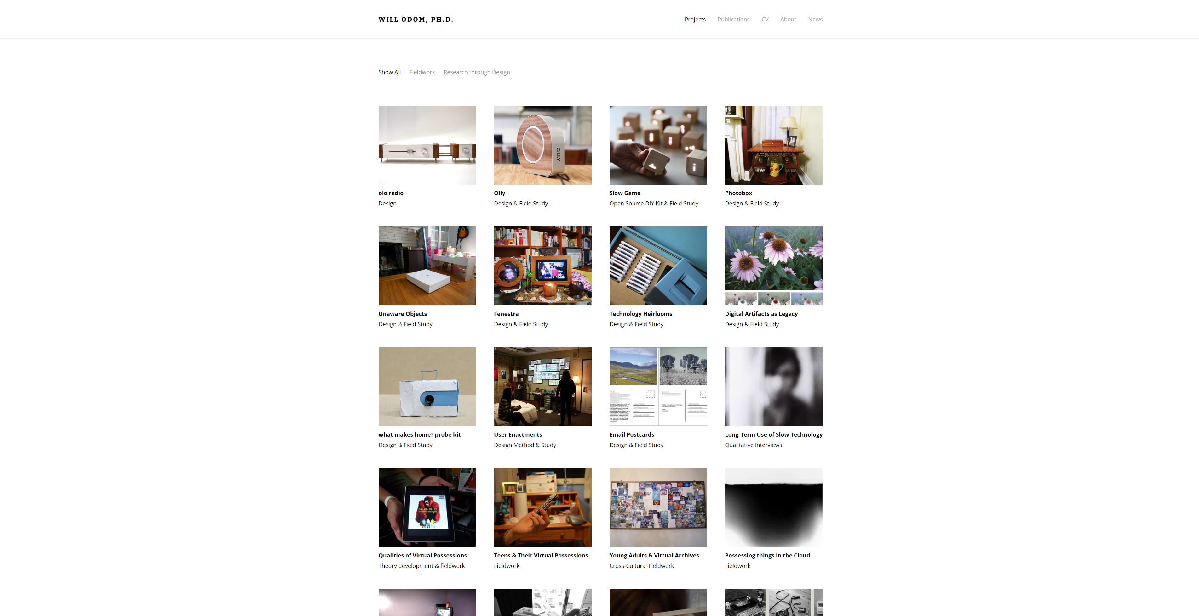
Notes:
http://willodom.com/

Slide 10
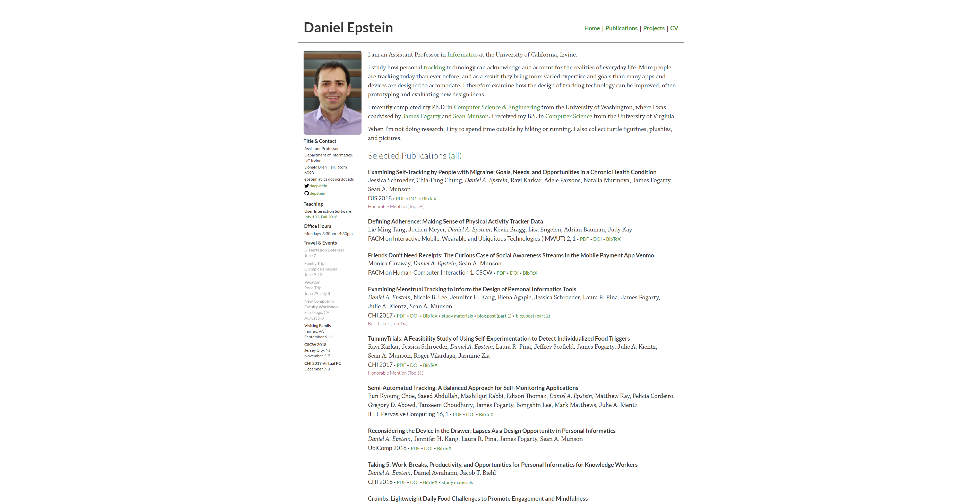

Slide 11
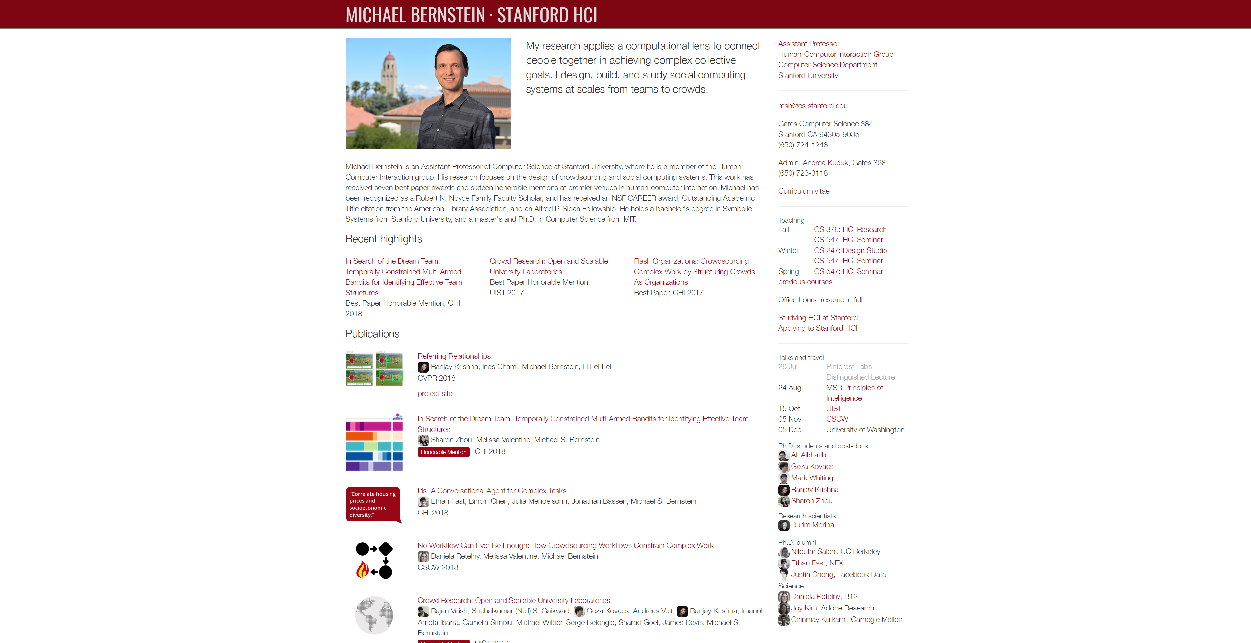
Notes:
http://hci.stanford.edu/msb/

Slide 12
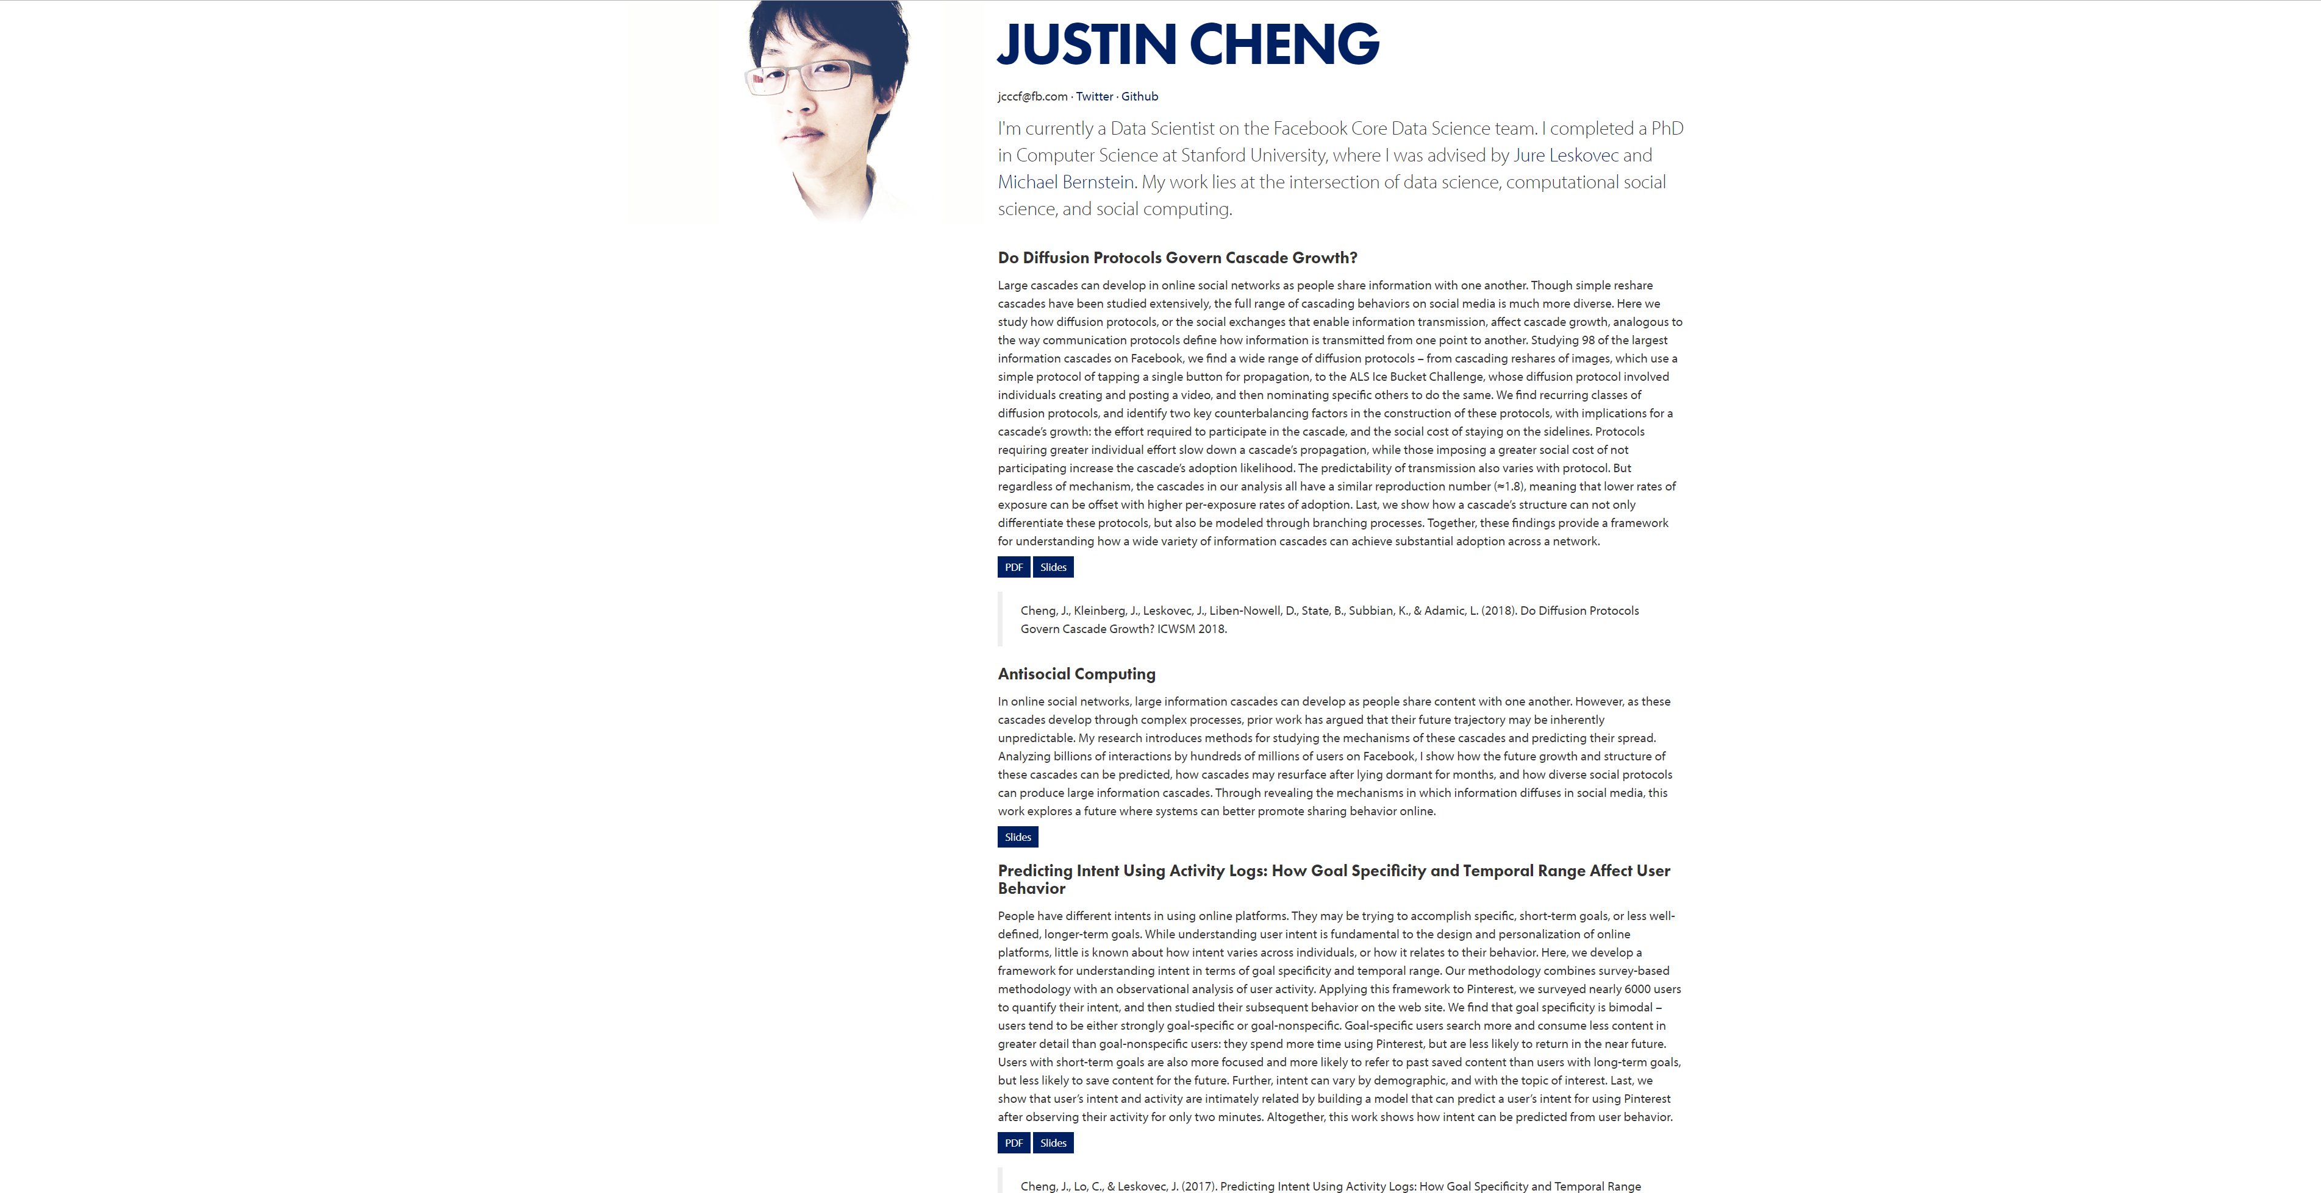
Notes:
https://www.clr3.com/

Slide 13
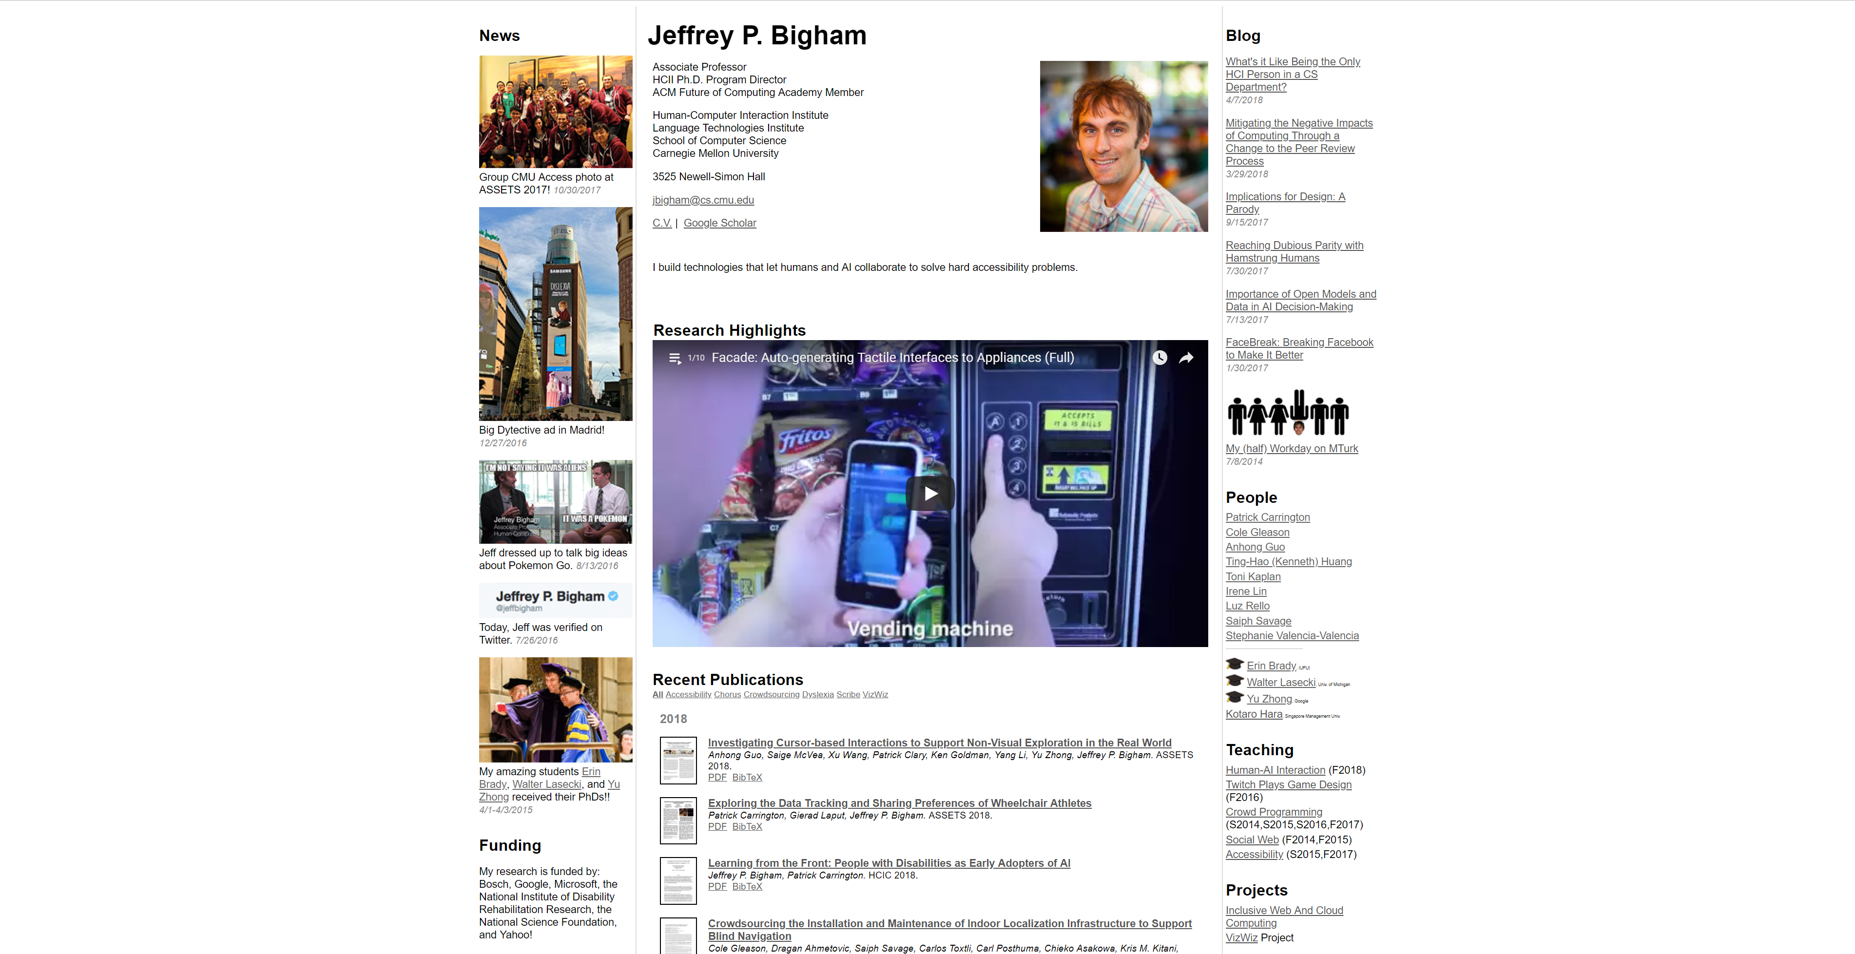
Notes:
https://www.cs.cmu.edu/~jbigham/

